Slide 1

UNIVERSITY INSTITUTE OF ENGINEERING
COMPUTER SCIENCE ENGINEERING
Bachelor of Engineering (Computer Science & Engineering)
Subject Name: Block chain Technology
Subject Code: 20_CST-412
Secure communication and encryption in Fabric networks. Mapped with CO3
Prepared By:
Er. Steve Samson
DISCOVER . LEARN . EMPOWER

Slide 2
Secure communication in fabric
Hyper ledger Fabric is a decentralized private block chain platform. Typically, we use the provided Fabric Client SDK to interact with the Fabric network. If we want the communication between these two to be secure, we can use the TLS (Transport Layer Security) protocol.

Slide 3
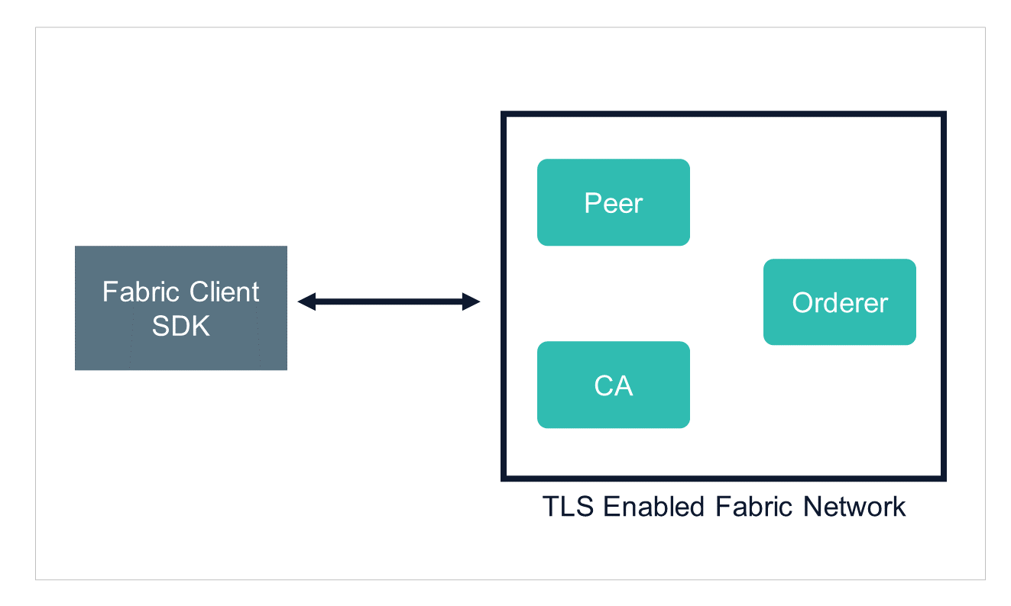

Slide 4
Why is TLS required in a Fabric network?
The main purpose of TLS is to provide secure communication between two parties which includes endpoint authentication, ensuring one is talking to the right party and with correct message encryption. It helps in the following common operations which occur between the Fabric client and Fabric network.
Client requests endorsement from peers
The client submits endorsed transactions to the orderer.
Client requests for registering users in Fabric CA (Certificate Authority) Server.

Slide 5
Channel-based Communication: Hyperledger Fabric employs channels to facilitate private and confidential communication between specific network participants. Each channel has its own ledger and smart contracts, and only authorized participants can access and transact on a given channel. This ensures that sensitive data is not visible to unauthorized parties.
Identity Management: Fabric utilizes cryptographic certificates and digital signatures to verify the identity of participants in the network. It relies on a certificate authority (CA) to issue and manage the certificates. Each participant has a unique identity that is used for authentication and authorization during communication

Slide 6
Example of Hyperledger Fabric
Suppose there's a manufacturer that wants to ship chocolates to a specific retailer or market of retailers (i.e., all US retailers) at a specific price but does not want to reveal that price in other markets (i.e., Chinese retailers).
Since the movement of the product may involve other parties, like customs, a shipping company, and a financing bank, the private price may be revealed to all involved parties if a basic version of blockchain technology is used to support this transaction.

Slide 7
Benefits Of Hyperledger Fabric
Open Source
Private and Confidential
Access Control
Chaincode Functionality
Performance

